Slide 1
Microsoft Excel 2013
Dr. Wameedh. T.M. Al-Tameemi

Slide 2
Excel 2013 Insert list

Slide 3
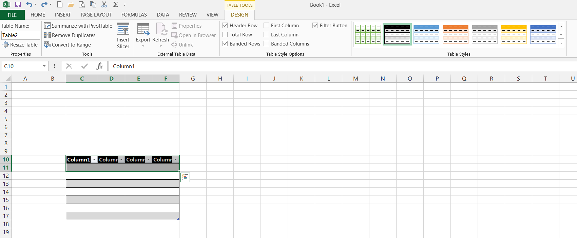
Excel 2013 Insert list
Inserting tables
Insert → table
→
→

Slide 4
Excel 2013 Insert list
Inserting tables
Insert → table
→
→

Slide 5
Excel 2013 Insert list
Inserting illustrations
Insert → illustrations → pictures
→
Choose the needed picture and press insert

Slide 6
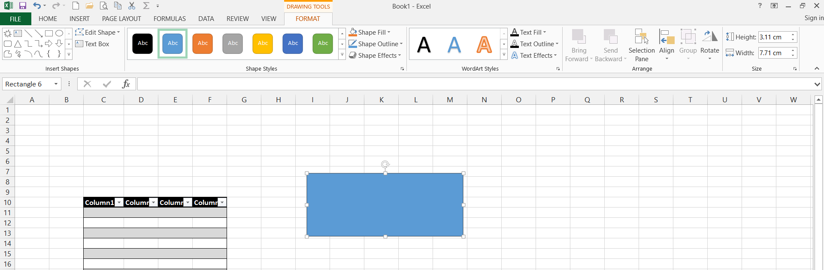
Excel 2013 Insert list
Inserting illustrations
Insert → illustrations → shapes
→
Choose the needed shape and place it in the needed place

Slide 7
Excel 2013 Insert list
Inserting illustrations
Insert → illustrations → smart art
→
Choose the needed smart art and press ok

Slide 8
Excel 2013 Insert list
Inserting illustrations
Insert → illustrations → screenshot
→
Select the needed area from an opened window or from the entire screen

Slide 9
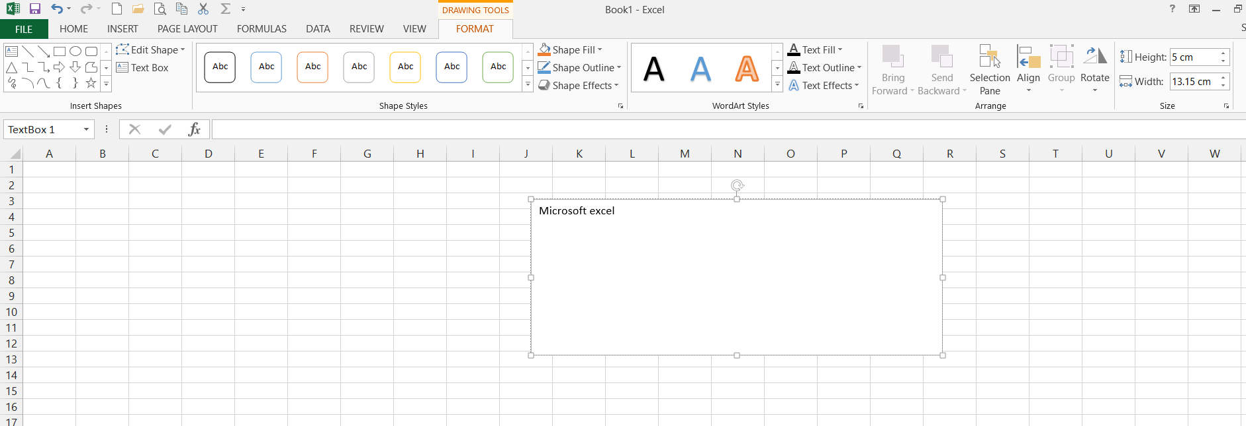
Excel 2013 Insert list
Inserting Text
Insert → text → text box
Draw the text box and format it as required
→

Slide 10
Excel 2013 Insert list
Inserting Text
Insert → text → header and footer
Format the Header and Footer as required
→

Slide 11
Excel 2013 Insert list
Inserting Text
Insert → text → WordArt
→
Choose the style and format the text as required
→

Slide 12
Excel 2013 Insert list
Inserting symbols
Insert → symbols→ equation
→
Write the needed equation in the textbox as required

Slide 13
Excel 2013 Insert list
Inserting symbols
Insert → symbols→ symbol
→
Choose the needed symbol

Slide 14
Excel 2013 Next
Next lecture: Insert list-2 – Page layout
Thank you very much

